Slide 1

Project Management
3
Systems Analysis and Design, 8e
Kendall & Kendall

Slide 2
Learning Objectives
Understand how projects are initiated and selected, define a business problem, and determine the feasibility of a proposed project.
Inventory and appraise current and proposed hardware and software and the way it supports human interactions with technology.
Evaluate software by addressing the tradeoffs among creating custom software, purchasing COTS software, and outsourcing to an application service provider.
Forecast and analyze tangible and intangible costs and benefits.
Plan a project by identifying activities and scheduling them.
Manage team members and analysis and design activities so that the project objectives are met while the project remains on schedule.
Professionally write and present an effective systems proposal, concentrating on both content and design.

Slide 3
Project Management Fundamentals
Project initiation
Determining project feasibility
Activity planning and control
Project scheduling
Managing systems analysis team members
Notes:
Project initiation – begins with problems or with opportunities for improvement in a business as the organization adapts to change.
Determining project feasibility – need to work with decision makers to determine if it is feasible.
Project scheduling – project activities are scheduled through the use of tools such as Gantt charts and PERT diagrams.
Planning and managing activities and team members – part of assuring the productivity of systems analysis team members is effectively managing scheduled activities.

Slide 4
Major Topics
Project initiation
Determining feasibility
Determining resources
Activity planning and control
  Gantt charts
  PERT diagrams
Managing analysis and design activities
The agile approach

Slide 5
Project Initiation
Problems in the organization
  Problems that lend themselves to systems solutions
Opportunities for improvement
  Caused through upgrading, altering, or installing new systems
Notes:
Both problems and opportunities can arise as the organization adapts to and copes with natural, evolutionary change.

Slide 6
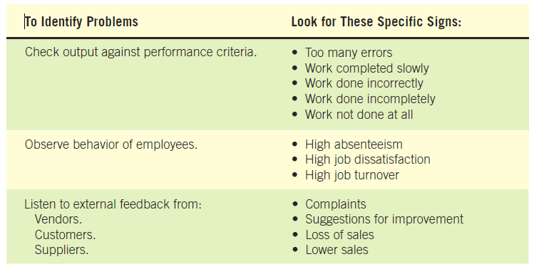
Checking Output, Observing Employee Behavior, and Listening to Feedback Are all Ways to Help the Analyst Pinpoint Systems Problems and Opportunities (Figure 3.1)

Slide 7
Problem Definition
Problem statement
  Paragraph or two stating the problem or opportunity
Issues
  Independent pieces pertaining to the problem or opportunity
Objectives
  Goals that match the issues point-by-point
Requirements
  The things that must be accomplished along with the possible solutions, and constraints, that limit the development of the system
Use the problem definition to create a preliminary test plan.
Notes:
Issues are the current situation, objectives are the desired situation.
Requirements may include security, usability, government requirements and so on.
Constraints might be budget restrictions or time limitations.

Slide 8
Problem Definition Steps
Find a number of points that may be included in one issue.
State the objective.
Determine the relative importance of the issues or objectives.
Identify which objectives are most critical.
Notes:
Before the problem definition is produced information is gathered from interviews, observations, and document analysis with the users. Major points are then identified as issues.
Once the issues are identified (current situation), objectives are stated (desired situation). Sometimes this may require follow-up interviews.
After the objectives are stated the relative importance of the issues or objectives is determined.
Due to constraints it is generally necessary to order the objectives to determine which are most critical.

Slide 9
Selection Of Projects
Backing from management
Appropriate timing of project commitment
Possibility of improving attainment of organizational goals
Practical in terms of resources for the system analyst and organization
Worthwhile project compared with other ways the organization could invest resources
Notes:
Backing from management – absolutely nothing can be accomplished without the endorsement of the people who eventually will foot the bill.
Appropriate timing of project commitment – can a time commitment be made for installation of new systems or improvement to existing ones.
Possibility of improving attainment of organizational goals – the project should put the organization on target, not deter it from its goals.
Practical in terms of resources for the system analyst and organization – is there expertise and resources to carry out the project.
Worthwhile project compared with other ways the organization could invest resources – when a business commits to one project it is committing resources that are unavailable for other projects.

Slide 10
Selection of Projects: Improving Attainment of Organizational Goals
Improving corporate profits
Supporting the competitive strategy of the organization
Improving cooperation with vendors and partners
Improving internal operations support
Improving internal decision support so that decisions are more effective
Improving customer service
Increasing employee morale

Slide 11
Defining Objectives
Many possible objectives exist including:
  Speeding up a process
  Streamlining a process
  Combining processes
  Reducing errors in input
  Reducing redundant storage
  Reducing redundant output
  Improving system and subsystem integration
Notes:
Improvements to systems can be defined as changes that will result in incremental but worthwhile benefits.

Slide 12
Determining Feasibility
Defining objectives
Determining resources
  Operationally
  Technically
  Economically
Notes:
The feasibility study must be highly time compressed, encompassing several activities in a short span of time.

Slide 13
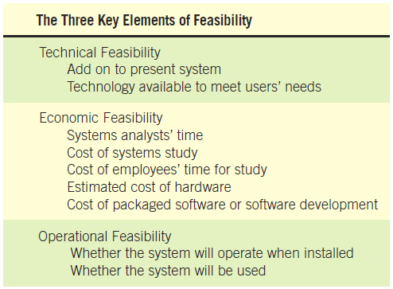
The Three Key Elements of Feasibility Include Technical, Economic, and Operational Feasibility (Figure 3.3)
Notes:
A project must be feasible in all three ways to merit further development.

Slide 14
Technical Feasibility
Can current technical resources be upgraded or added to in a manner that fulfills the request under consideration?
If not, is there technology in existence that meets the specifications?
Notes:
Sometimes add-0ns are costly and not worthwhile, because they meet needs inefficiently.

Slide 15
Economic Feasibility
Economic feasibility determines whether value of the investment exceeds the time and cost.
Includes:
  Analyst and analyst team time
  Business employee time
  Hardware
  Software
  Software development
Notes:
If short-term costs are not overshadowed by long-term gains or produce no immediate reduction in operating costs, the system is not economically feasible.

Slide 16
Operational Feasibility
Operational feasibility determines if the human resources are available to operate the system once it has been installed.
Users that do not want a new system may prevent it from becoming operationally feasible.
Notes:
If users are satisfied with current system resistance to implementing a new system will be strong.
If users are dissatisfied with the current system and have expressed a need for change chances are that the new system will be used.

Slide 17
Ascertaining Hardware and Software Needs
Steps used to determine hardware and software needs:
  Inventory computer hardware currently available
  Estimate current and future system workloads
  Evaluate available hardware and software
  Choose the vendor
  Acquire the computer equipment
Notes:
Only when systems analysts, users, and management have a good grasp of what kinds of tasks must be accomplished can hardware options be considered.

Slide 18
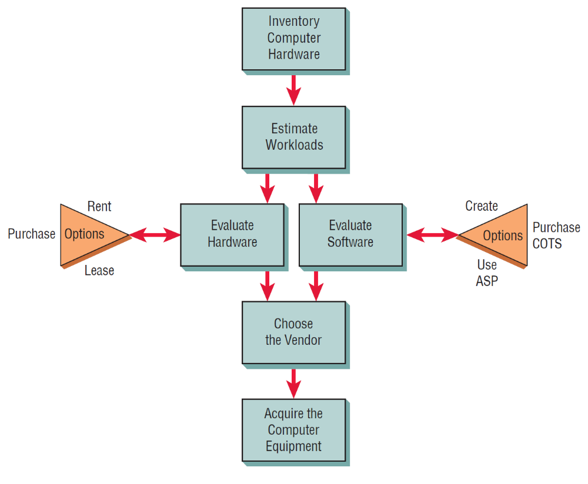
Steps in Choosing Hardware and Software (Figure 3.4)

Slide 19
Inventorying Computer Hardware
Type of equipment
Operation status of the equipment
Estimated age of equipment
Projected life of equipment
Physical location of equipment
Department or person responsible for equipment
Financial arrangement for equipment
Notes:
Begin by inventorying what computer hardware is already available in the organization.
Type of equipment – model number, manufacturer.
Operation status of the equipment – on order, in storage, in need of repair.
Financial arrangement for equipment – owned, leased, rented.

Slide 20
Estimating Workloads
Systems analysts formulate numbers that represent both current and projected workloads for the system so that any hardware obtained will possess the capability to handle current and future workloads.
Notes:
The newly-proposed system should cut down required human and computer time.

Slide 21
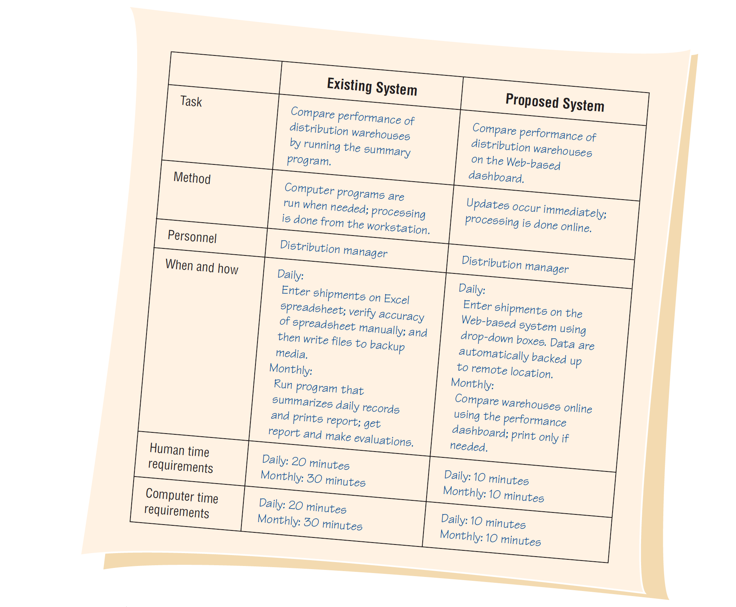
Comparisons of Workloads between Existing and Proposed Systems (Figure 3.5 )
Notes:
If estimates are accomplished properly, the business should not have to replace hardware solely due to unforeseen growth in system use.

Slide 22
Evaluating Hardware
Time required for average transactions
Total volume capacity of the system
Idle time of the CPU or network
Size of memory provided
Notes:
Criteria that the systems analysts and users should use to evaluate performance of different systems hardware:
Time required for average transactions – including how long it takes to input data and how long it takes to receive output.
Total volume capacity of the system – how much can be processed at the same time before a problem arises.
Idle time of the CPU or network
Size of memory provided

Slide 23
People that Evaluate Hardware
Management
Users
Systems analysts
Notes:
Evaluating computer hardware is the shared responsibility of management, users, and systems analysts. Although vendors supply details about their offerings, analysts oversee the evaluation personally. Systems analysts will educate users and administration about advantages and disadvantages.

Slide 24
Acquisition of Computer Equipment
Purchasing
Leasing
Rental
Notes:
Influential factors:
Initial versus long-term costs.
Can capital afford to be tied up in computer equipment.
Should the business have full control of and responsibility for the computer equipment.

Slide 25
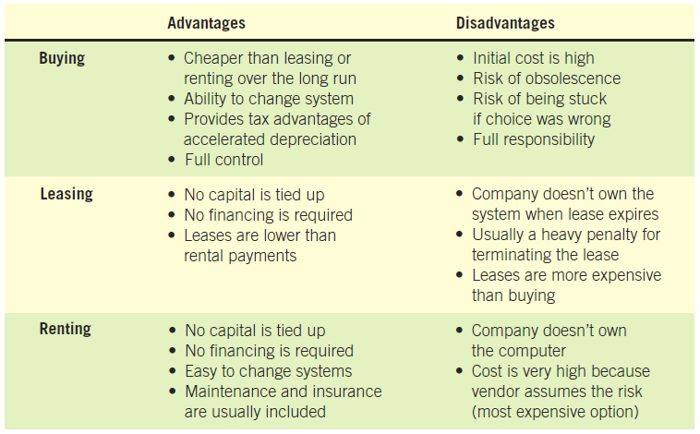
Purchasing, Leasing, and Renting Advantages and Disadvantages (Figure 3.6)
Notes:
Main determinants – projected life of the system.
As systems become smaller, more powerful, less expensive, and distributed systems become increasingly popular, more businesses are deciding to purchase equipment.

Slide 26
Evaluating Vendor Support
Hardware support
Software support
Installation and training support
Maintenance support
Notes:
Peruse the support services documents accompanying the purchase or lease of equipment and remember to involve appropriate legal staff before signing contracts for equipment or services.

Slide 27

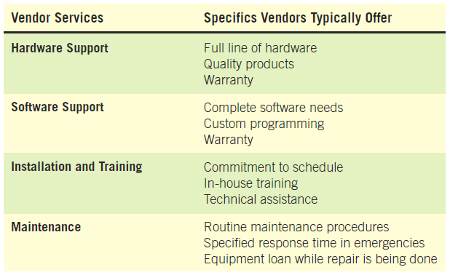
Evaluating Vendor Support
(Figure 3.8)

Slide 28
Other Considerations
Possibility of adding on to the system
Interfacing with equipment from other vendors
Adding more memory
Corporate stability of the vendor
Notes:
Evaluating computer hardware is not as straight forward as simply comparing costs and choosing the least expensive option.

Slide 29
Software Alternatives
Created custom software
Purchased as COTS (commercial off-the-shelf) software
Provided by an application service provider (ASP)
Notes:
It is imperative to complete a human information requirements analysis of the users and the systems they use first.

Slide 30
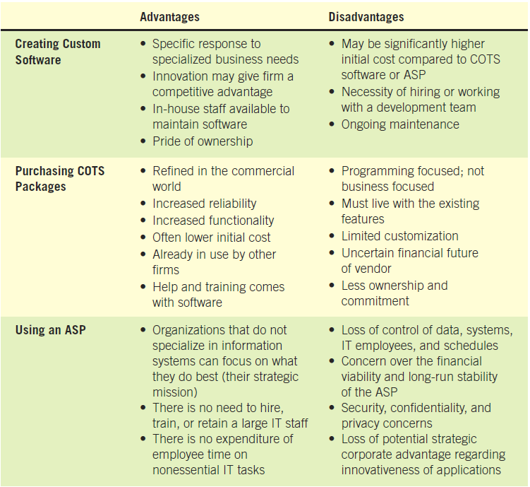
Software Alternatives (Figure 3.9)

Slide 31
Software Evaluation
Performance effectiveness
Performance efficiency
Ease of use
Flexibility
Quality of documentation
Manufacturer support

Slide 32
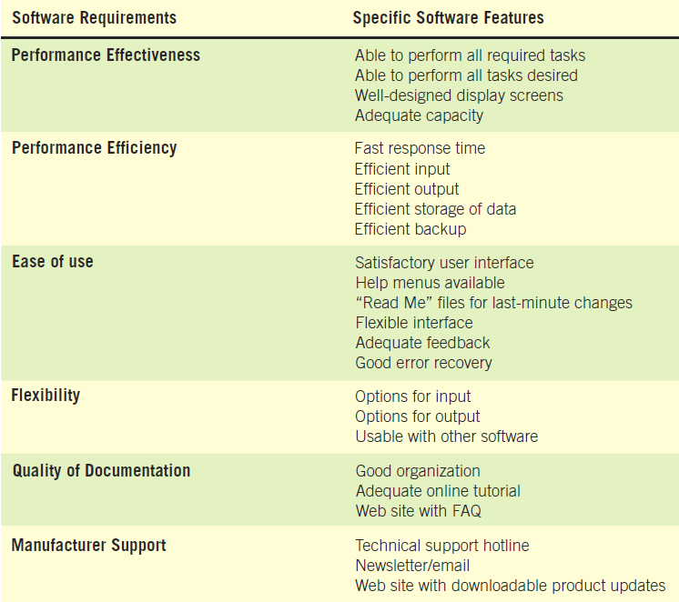
Guidelines for Evaluating Software
(Figure 3.10)
Notes:
Evaluate packaged software based on a demonstration with test data from the business considering it and an examination of accompanying documentation.

Slide 33
Activity Planning and Control
Planning includes:
  Selecting a systems analysis team
  Estimating time required to complete each task
  Scheduling the project
Control includes:
  Comparing the plan for the project with its actual evolution
  Taking appropriate action to expedite or reschedule activities

Slide 34
Identifying and Forecasting Costs and Benefits
Judgment methods
  Estimates from the sales force
  Surveys to estimate customer demand
  Delphi studies
  Creating scenarios
  Drawing historical analogies
Notes:
Conditions for choosing a model are judgment methods
judgment methods – if historical data are available then consider whether the forecast is conditional or unconditional

Slide 35
Identifying and Forecasting Costs and Benefits (Continued)
If historical data are available
  Conditional:
    There is an association among variables in the model.
  Unconditional:
    Do not need to find or identify any relationships.
Notes:
Conditional – correlation regression, leading indicators, econometrics, and input/out models.
Unconditional – judgment, moving average, and analysis of time series data.

Slide 36
Estimation of Trends
Graphical judgment
Moving averages

Slide 37
Identifying Benefits and Costs
Tangible benefits are advantages measurable in dollars through the use of the information system.
Intangible benefits are difficult to measure.
Tangible costs are accurately projected by the systems analyst and accounting personnel.
Intangible costs are difficult to estimate and may not be known.
Notes:
Both tangible and intangible cost must be taken into account when systems are considered.

Slide 38
Tangible Benefits
Advantages measurable in dollars that accrue to the organization through the use of the information system
Examples:
  Increase in the speed of processing
  Access to otherwise inaccessible information
  Access to information on a more timely basis
  The advantage of the computer’s superior calculating power
  Decreases in the amount of employee time needed to complete specific tasks
Notes:
Tangible benefits can be measured in terms of dollars, resources, or time saved.

Slide 39
Intangible Benefits
Intangible benefits are benefits from use of the information system that are difficult to measure.
Examples:
  Improving the decision-making process
  Enhancing accuracy
  Becoming more competitive in customer service
  Maintaining a good business image
  Increasing job satisfaction
Notes:
Both tangible and intangible benefits must be discussed in the proposal, both will allow decision makers to make a well-informed decision about the proposed system.

Slide 40
Tangible Costs
Those that can be accurately projected by systems analysts and the business’ accounting personnel
Examples:
  Cost of equipment
  Cost of resources
  Cost of systems analysts’ time
  Cost of programmers’ time
  Employees’ salaries
Notes:
These costs are well established and are the costs that require a cash outlay of the business.

Slide 41
Intangible Costs
Those that are difficult to estimate and may not be known
Examples:
  Losing a competitive edge
  Losing the reputation of being first
  Declining company image
  Ineffective decision making
Notes:
It is generally not possible accurately to project a dollar amount for intangible costs.

Slide 42
Comparing Costs and Benefits
Break-even analysis
Payback
Cash-flow analysis
Present value analysis
Notes:
All these techniques provide straightforward ways of yielding information to decision makers about the worthiness of the proposed system.

Slide 43
Break-Even Analysis
The point at which the total cost of the current system and the proposed system intersect
Useful when a business is growing and volume is a key variable in costs
Disadvantage:
  Benefits are assumed to remain the same
Advantage:
  Can determine how long it will take for the benefits of the system to pay back the costs of developing it
Notes:
Total costs = costs that recur during operation of the system + developmental costs that occur only once

Slide 44
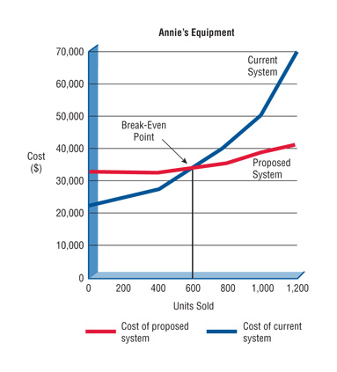
Break-Even Analysis (Figure 3.11)

Slide 45
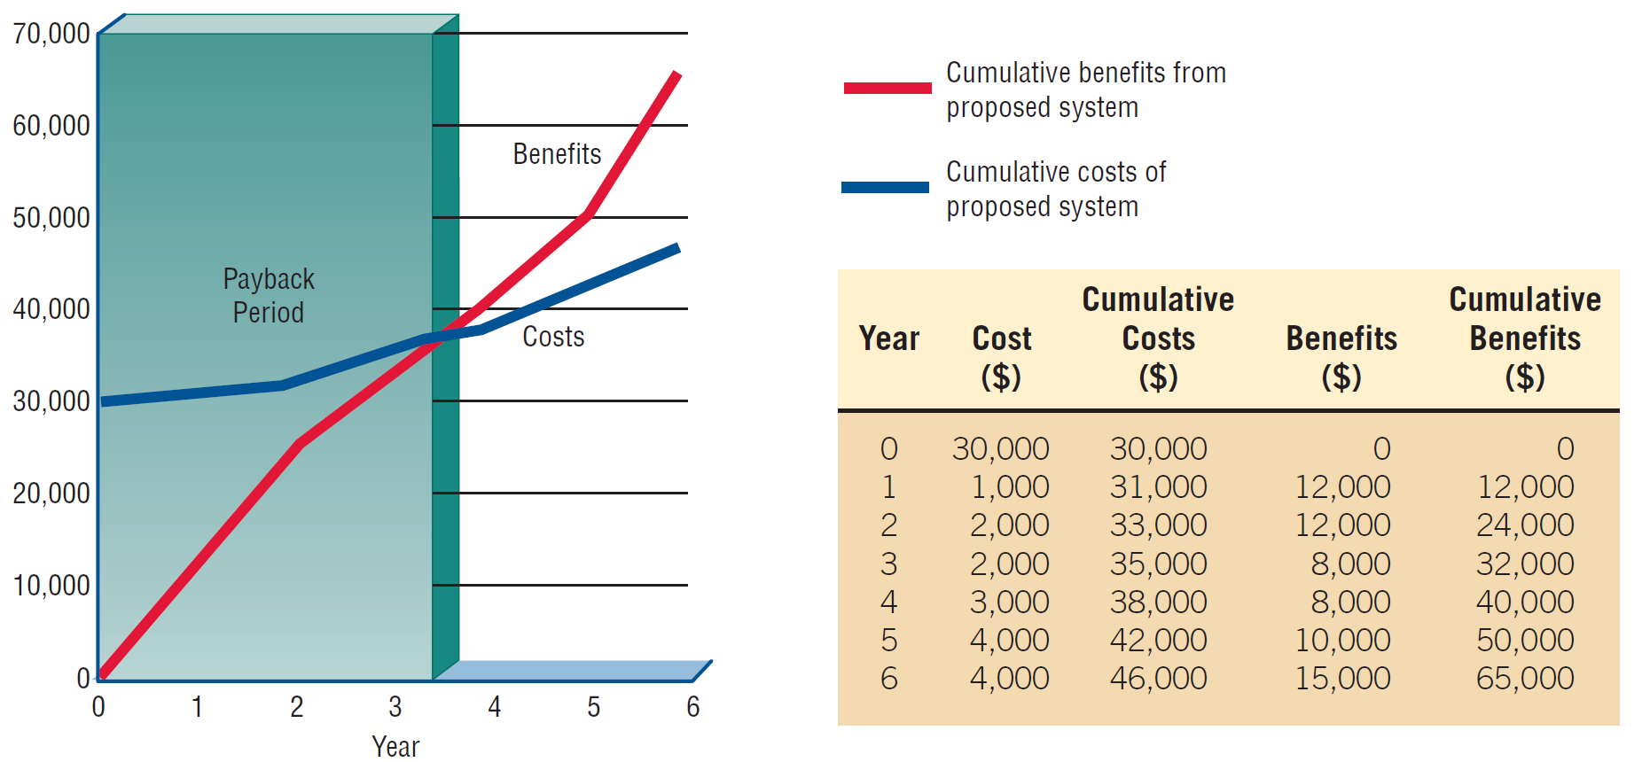
Break-Even Analysis Showing a Payback Period of Three and a Half Years (Figure 3.12)

Slide 46
Cash-Flow Analysis
Examines the direction, size, and pattern of cash flow that is associated with the proposed information system
Determines when cash outlays and revenues will occur for both; not only for the initial purchase, but over the life of the information system
Notes:
Cash-flow analysis is used to determine when a company will begin to make a profit and when it will be “out of the red”.

Slide 47
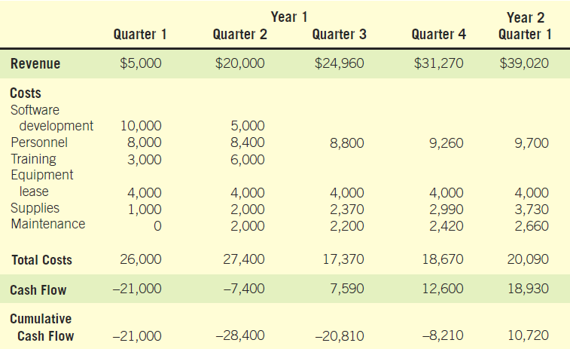
Cash-Flow Analysis for the Computerized Mail-Addressing System (Figure 3.13)

Slide 48
Present Value Analysis
Way to assess all the economic outlays and revenues of the information system over its economic life, and to compare costs today with future costs and today’s benefits with future benefits
Presents the time value of the investment in the information system as well as the cash flow
Notes:
The cost of money is the opportunity cost, or rate that could be obtained if the money invested in the proposed system were invested in another project.

Slide 49
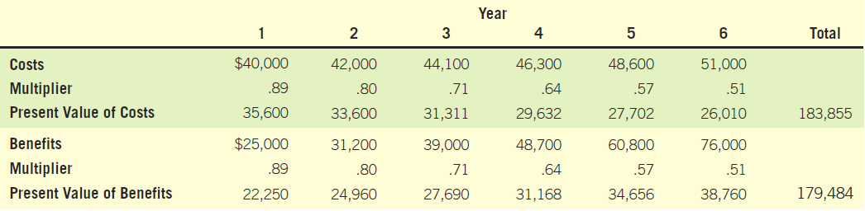
Present Value Analysis (Figure 3.15)
Taking into account present value, the conclusion is that the costs are greater than the benefits.
The discount rate, i, is assumed to be .12 in calculating the multipliers in this table.

Slide 50
Guidelines for Analysis
  Use break-even analysis if the project needs to be justified in terms of cost, not benefits.
  Use payback when the improved tangible benefits form a convincing argument for the proposed system.
  Use cash-flow analysis when the project is expensive, relative to the size of the company.
  Use present value when the payback period is long or when the cost of borrowing money is high.
Notes:
Whichever method remember that cost-benefit analysis should be approached systematically, in a way that can be explained and justified to managers.

Slide 51
Estimating Time
Project is broken down into phases.
Further project is broken down into tasks or activities.
Finally project is broken down into steps or even smaller units.
Time is estimated for each task or activity.
Most likely, pessimistic and optimistic estimates for time may be used.

Slide 52
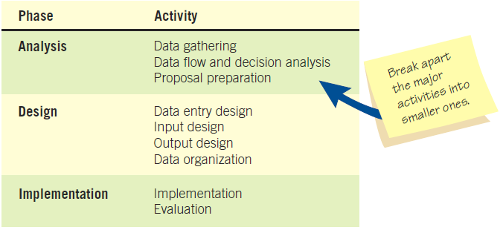
Beginning to Plan a Project by Breaking it into Three Major Activities (Figure 3.16)

Slide 53
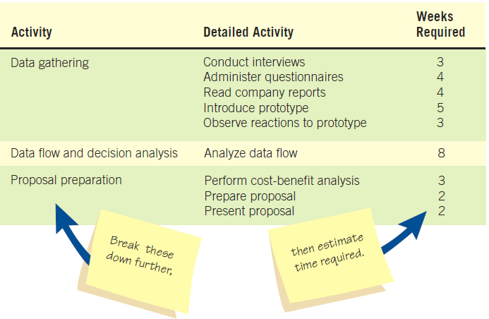
Refining the Planning and Scheduling of Analysis Activities by Adding Detailed Tasks and Establishing the Time Required to Complete the Tasks (Figure 3.17)

Slide 54
Project Scheduling
Gantt Charts
  Simple
  Lends itself to end user communication
  Drawn to scale
PERT diagrams
  Useful when activities can be done in parallel

Slide 55
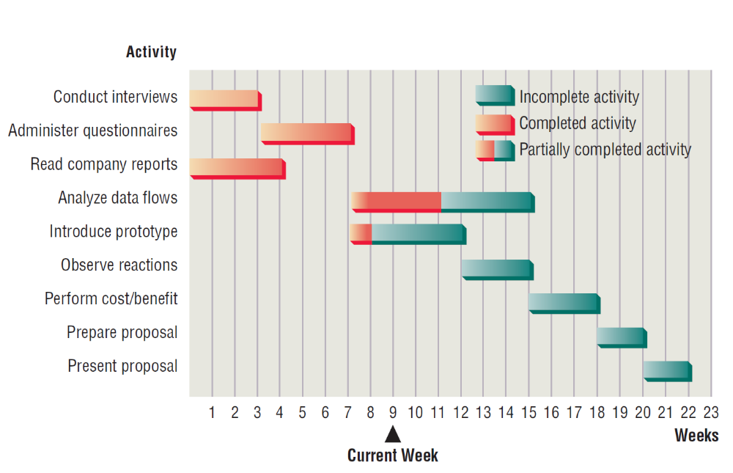
Using a Two-Dimensional Gantt Chart for Planning Activities that Can Be Accomplished in Parallel (Figure 3.18)

Slide 56
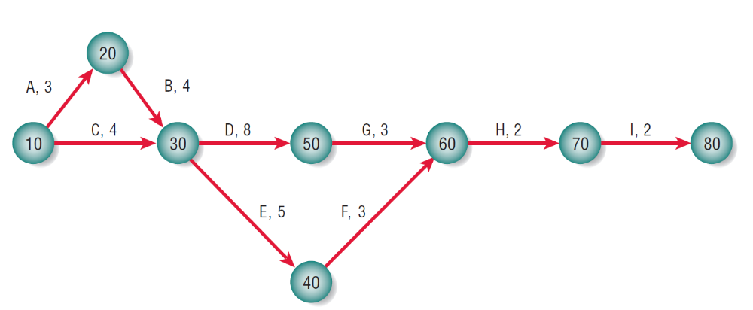
A Completed PERT Diagram for the Analysis Phase of a Systems Project (Figure 3.22)

Slide 57
PERT Diagram Advantages
Easy identification of the order of precedence
Easy identification of the critical path and thus critical activities
Easy determination of slack time

Slide 58
Project Due Dates
Estimating models
  Costar
  Construx
Function point analysis
  Helps the analyst quantitatively estimate the overall length of software development efforts

Slide 59
Managing Analysis and Design Activities
Team management
  Assembling a team
  Team communication strategies
  Project productivity goals
  Team member motivation

Slide 60
Assembling a Team
Shared value of team work
Good work ethic
Honesty
Competency
Readiness to take on leadership based on expertise
Motivation
Enthusiasm for the project
Trust of teammates
Notes:
Experience – this could mean code is developed five times faster
Motivation – select good people at the outset
Enthusiasm - Not only enthusiasm, but imagination and the ability to communicate with different kinds of people
Trust – people may have different work styles, but they all need to agree to work together toward a common goal.

Slide 61
Communication Strategies
Teams often have two leaders:
  Task leader: leads members to accomplish tasks
  Socioemotional leader: concerned with social relationships
The systems analyst must manage:
  Team members
  Their activities
  Their time and resources

Slide 62
Project Productivity Goals and Motivation
Successful projects require that reasonable productivity goals for tangible outputs and process activities be set.
Goal-setting helps to motivate team members.

Slide 63
Ecommerce Project Management
Ecommerce and traditional software project management differences:
  The data used by ecommerce systems is scattered across the organization.
  Ecommerce systems need a staff with a wide variety of skills.
  Partnerships must be built externally and internally well ahead of implementation.
  Security is of utmost importance.

Slide 64
Project Charter
  Describes in a written document what the expected results of the systems project are and the time frame for delivery

Slide 65
Project Charter Clarifies these Questions
What does the user expect of the project?
What is the scope of the project?
What analysis methods will the analyst use to interact with users?
Who are the key participants?
What are the project deliverables?
Who will evaluate the system and how will they evaluate it?
What is the estimated project timeline?
Who will train the users?
Who will maintain the system?

Slide 66
Project Failures
Project failures may be prevented by:
  Training
  Experience
  Learning why other projects have failed
Fishbone diagram systematically lists all of the possible problems that can occur

Slide 67
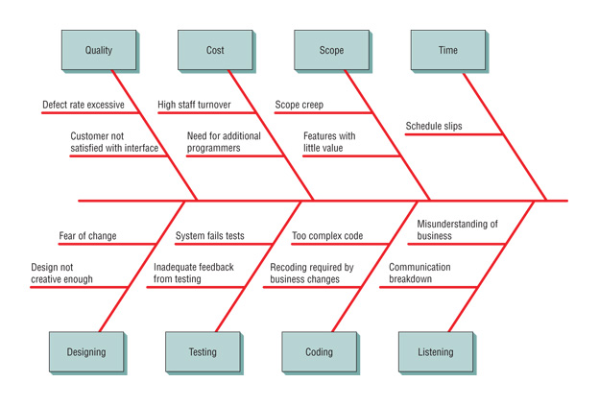
Fishbone Diagram (Figure 3.23)

Slide 68
The Systems Proposal
Cover letter
Title page of project
Table of contents
Executive summary
Outline of systems study with appropriate documentation
Detailed results of the systems study
Systems alternatives
Systems analysts recommendations
Summary
Appendices
Notes:
Ten main sections comprise the systems proposal.
Cover letter – should list the people who did the study and summarize the objectives of the study. Concise and friendly.
Title page of project – name of the project, the names of the team members, date submitted.
Table of contents – useful to readers of long proposals; omit if less than 10 pages.
Executive summary – precisely provides the who, what, when , where, why, and how of the proposal.
Outline of systems study with appropriate documentation – provides information about all the methods used in the study and who or what was studied.
Detailed results of the systems study – describes what was found out about human and systems needs through all the methods described in the detailed results of the systems study.
Systems alternatives - two or three alternatives that directly address the problem.
Systems analysts recommendations – the recommended solution.
Summary – brief statement that mirrors the content of the executive summary. Conclude the proposal on a positive note.
Appendices – can include any information that may be of interest.

Slide 69
Using Figures for Effective Communication
Effective use of tables
Effective use of graphs
Notes:
Integrating figures into your proposal helps demonstrate that you are responsive to the different ways people absorb information.

Slide 70
Effective Use of Tables
Integrate into the body of the proposal
Try to fit the entire table vertically on a single page.
Number and title the table at the top of the page.
Label each row and column.
Use a boxed table if room permits.
Use footnotes if necessary to explain detailed information contained in the table.
Notes:
Integrate into the body of the proposal – don’t regulate them to the appendices.
Number and title the table at the top of the page – Make the title descriptive and meaningful.
Label each row and column – use more than one line for a title if necessary.
Use a boxed table if room permits – vertically ruled columns will enhance the readability.

Slide 71
Effective Use of Graphs
Choose a style of graph that communicates your intended meaning well.
Integrate the graph into the body of the proposal.
Give the graph a sequential figure number and a meaningful title.
Label each axis, and any lines, columns, bars, or pieces of the pie on the graph.
Include a key to indicate differently colored lines, shaded bars, or crosshatched areas.

Slide 72
Summary
Project management fundamentals
  Project initiation
  Determining project feasibility
  Activity planning and control
  Project scheduling
  Managing systems analysis team members
Problem definition
  Issues of the present system
  The objective for each issue
  The requirements that must be included in all proposed systems

Slide 73
Summary (Continued)
Project selection
  Backed by management
  Commitment of resources
  Attains goals
  Practical
  Important
Feasibility
  Operational
  Technical
  Economic

Slide 74
Summary (Continued)
Acquiring hardware and software
Project planning
  Gantt charts
  PERT
  Function point analysis
Team management
Ecommerce projects
Preparing a system proposal

Slide 75

All rights reserved. No part of this publication may be reproduced, stored in a retrieval system, or transmitted, in any form or by any means, electronic, mechanical, photocopying, recording, or otherwise, without the prior written permission of the publisher. Printed in the United States of America.
Copyright © 2011 Pearson Education, Inc.
Publishing as Prentice Hall

